Slide 1
MGT388 Finance for Engineers
Appraisal of Annual Reports Using Ratio Analysis

Slide 2
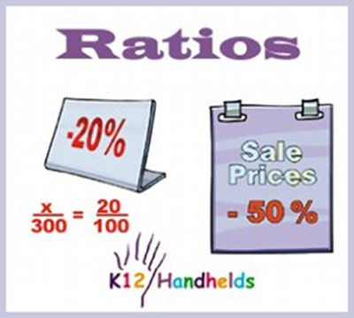
Lecture Outline
Introduction to ratio analysis
Profitability ratios
Liquidity ratios
Gearing/Solvency ratios

Slide 3
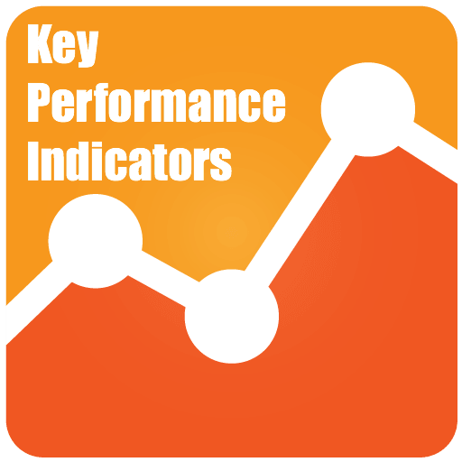
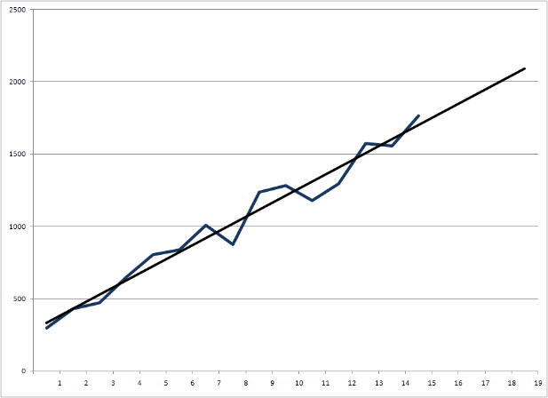



How are ratios used
Operating profit margin
Customer satisfaction
Carbon emissions
Can depict easily in charts/graphs
Can help compare results over time
Allows comparison of organisations of different size, location and type.

Slide 4

Introduction To Ratio Analysis
The calculation of a ratio is a start but it is the interpretation that is important.
A successful understanding of a company’s performance only comes from looking at the reasons for changes or differences in the ratios.
Gross profit margin up 20%
Market share?
Unsold stock?

Slide 5



Smoothie company

Slide 6
Example
VEG is an entity that started trading in January 2016 manufacturing and selling vegetable “smoothie” drinks. The entity uses innovative technology that pasteurises fresh drinks and gives them a shelf life of 8 weeks. VEG currently operates solely in Country X and is the only producer to use this technology to date.
The 2 directors of VEG initially invested £50,000 of share capital to start the business. The long-term borrowings were secured in January 2016 under a business start-up initiative, and will be repaid over 4 years commencing January 2017. The directors also negotiated a short term bank overdraft facility of £75,000 which is intended to cover payments to suppliers. The overdraft is due to be reviewed 1 April 2018.

Slide 7
Example
VEG has performed well in its first year of trading, selling to 3 large supermarkets and securing a contract with another supermarket to produce an own-brand product. This contract was signed in October 2016. The directors believe that VEG could exploit similar opportunities in both domestic and overseas markets if they expanded further. However any further expansion would require significant investment in property, plant and equipment.
You are looking to buy shares in VEG as you have been told about the potential of the company and the directors are interested in your investment as it would potentially allow them to undertake the investment required to expand.
The administrative expenses for the year ended 31 December 2016 includes professional fees of £30,000 incurred in the business set up, £40,000 in marketing and £20,000 for the cost of training staff in the production process.

Slide 8
Lecture Example Adapted from CIMA F2 paper May 2014
Income Statement 2017 2016
Forecast Actual
£’000 £’000
Revenue 1,020 800
Cost of sales (620) (520)
Gross profit 400 280
Operating expenses (190) (210)
Operating profit 210 70
Finance costs (25) (20)
Profit before tax 185 50
Taxation ( 30) (20)
Profit for the year 155 30

Slide 9
Lecture Example Adapted from CIMA F2 paper May 2014
Statement of Financial Position as at 31 December 2016
£’000 £’000
Non-current assets Equity and Liabilities
Property, plant and Ordinary shares 100
equipment 350 Retained earnings 30
Intangible assets 52 130
402 Non-current liabilities
Current assets Long term debt 350
Inventories 40
Receivables 140 Current Liabilities
180 Trade payable 50
Corporation tax 12
Overdraft 40
102
Total assets 582 Total equity &liabilities 582
Notes:
9

Slide 10

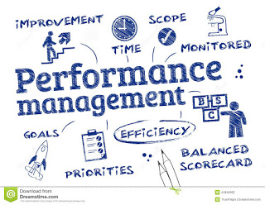
Analysis of Management Performance Profitability Ratios
Return on capital employed (ROCE)
Gross profit margin
Operating profit margin
Net asset turnover

Slide 11


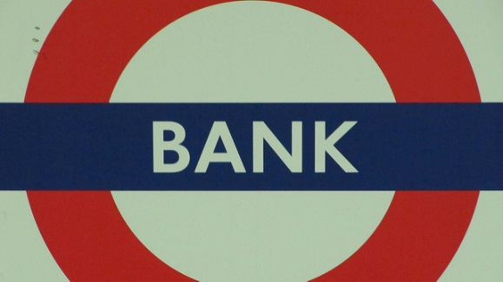
Return on Capital Employed (ROCE)
ROCE = Operating profit
Equity funds + Non Current liabilities
Money from shareholders
Can the business turn the money into profits?
Money from banks

Slide 12
Return on Capital Employed (ROCE)
The ROCE indicates how successfully the management are using the funds provided to them from shareholders and debentures holders.
It can help shareholders and providers of finance decide whether to invest in the company, by indicating how well funds provided in the past have been used (in terms of generating profits).

Slide 13
Return on Capital Employed (ROCE)
2016 ROCE
ROCE = Operating profit
Equity + Non Current Liabilities
ROCE = 70
130 + 350
ROCE = 14.6%

Slide 14
Return on Capital Employed (ROCE)
ROCE = 14.6%
For every £1 that has been invested in the business the management have achieved a 14.6p return.
You will want to compare the return with similar firms, the past and other investment opportunities.(Bank-savings a/c)
The level of return is also linked to the level of risk.
VEG: is a new venture
has a fashionable product
has a reliance on a few large supermarkets for sales and
uses innovative technology which may be copied or improved upon
A higher return may be required due to the higher level of risk

Slide 15
Return on Capital Employed (ROCE)
The ROCE figure achieved by a business may be as a result of:
Profitability – Gross profit and operating profit margins
AND/OR
Efficient utilisation of assets – Net asset turnover

Slide 16
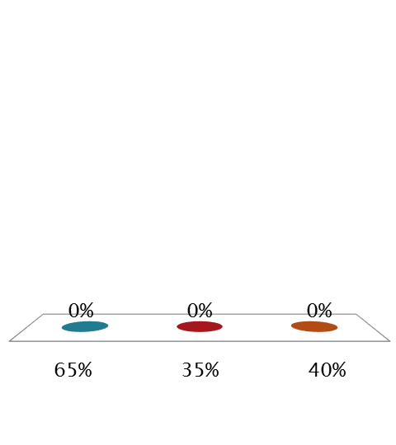
Gross profit margin:Gross profit x 100% Turnover What is the gross profit margin for VEG for 2016?
65%
35%
40%

Slide 17
Profitability
Gross profit margin
Gross profit 280 = 35%
Turnover 800
Indicates how profitable the core business is. The only expense category in gross profit is cost of sales.
Every £1 of revenue converts to 35p gross profit.
Forecast gross profit margin 400 = 39.2%
1,020

Slide 18
Profitability
A business and investors would like to see a constant gross margin.
However for VEG
It relies on raw materials, in this case vegetables – this means prices are more volatile and margins are not constant.
A policy of increasing market share may mean a reduction in sales price and a reduced margin.
If new entrants joined the market, the increased competition may force down the price and reduce gross profit margin.

Slide 19

Operating profit margin: Operating profit x 100% Turnover What is the operating profit margin for VEG for 2016?
9%
6%
26%

Slide 20
Profitability
Operating profit margin = Operating profit 70 8.8% Turnover 800
Operating profit includes cost of sales, administration and distribution costs.
Every £1 of turnover is being converted into 8.8p profit.
Forecast operating profit margin 210/1,020 20.6%
If there is a change in operating profit margin need to highlight which expense has increased/decreased and explain. Look at cost control by management.
Notes:
20

Slide 21
Analysis of the Profitability of VEG
VEG has managed to achieve a gross profit margin of 35% and the directors are anticipating an increase in the gross profit to 39.2%.
This could be due to better margins having been negotiated in the contract with the supermarket for the own-brand product, meaning that the own-brand smoothies should be pursued with other supermarkets as this is clearly a lucrative deal.
Alternatively the improved gross margin could be the result of greater economies of scale in purchasing or indeed greater efficiency in the production process now that staff are fully trained and presumably working at full efficiency.
The operating profit margin was 8.8% in 2016, however this was after charging professional fees and training costs, which would not be expected to recur in such significant amounts. It is likely that further marketing may be undertaken (finance permitting), however directors are still anticipating that the operating profit margin will increase to 20.6% in 2017.

Slide 22
Efficiency
Net asset turnover
Turnover 800
Equity + non-current liabilities 350+130
Net asset turnover = 1.67 times
For every £1 worth of investment available £1.67 of turnover is generated.

Slide 23
Efficiency
The net asset turnover figure can be compared over time and against companies in the same industry to assess if management are utilising the resources at there disposal to generate revenue.
But a large component of assets are non-current assets which are subject to depreciation and therefore a company with old assets will have a low figure for assets. But when those assets are initially replaced or in an expansion the asset figure will be high.
Investment in assets may not translate to increased revenue immediately turnover. There may be a time lag between an investment and an improved net asset turnover ratio.
If the business is labour intensive rather than requiring physical assets then turnover to staff costs/ no of employees may be useful to show the amount of revenue per employee.

Slide 24
Management Performance
ROCE
Is the key ratio to how a company is performing this can be explained in isolation but is a product of a company’s profitability and efficiency
ROCE = Operating profit margin X net asset turnover
Operating profit = Operating profit X Turnover
Equity +Non-current Turnover Equity +Non-liabilities current liabilities
14.6%= 8.8% X 1.67

